Slide 1
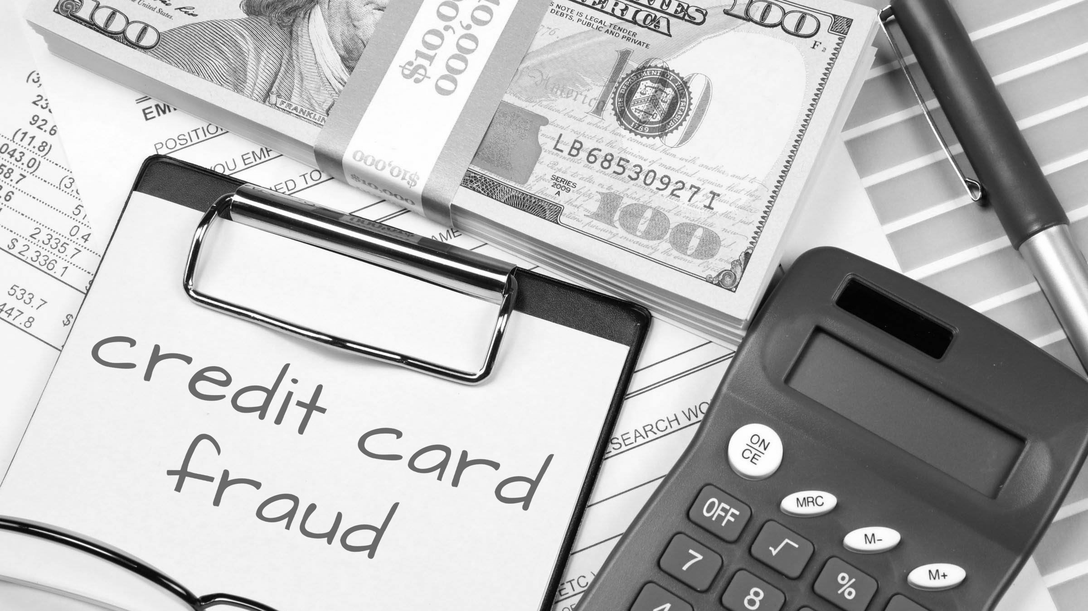
Credit Card Fraud Trends and Predictions
Team 1 Authors:
Ashleigh Bridges, Sean Flinn, Sha’Irene Reid, Rebecca Allison , Mike Bowman

Slide 2
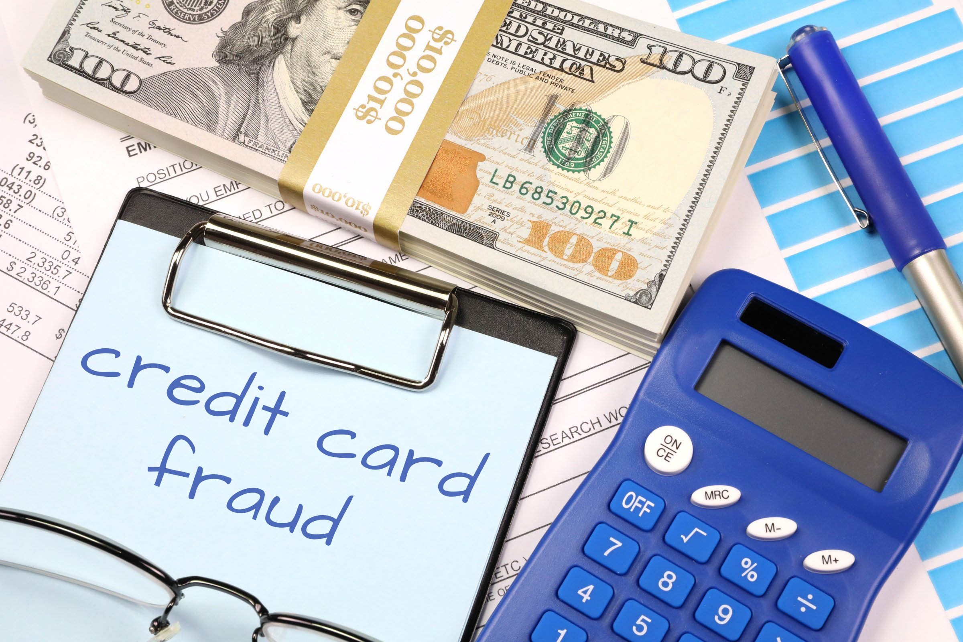
Why Credit Card Fraud?
We chose this topic due to our team’s background in the financial service sector and two teammates with credit card experience.

Slide 3

Source of Data
Our Dataset is a simulated credit card transaction dataset, covering the cards of 1000 customers with a pool of 800 merchants.
Data set covers transactions over a full two-year period.
Contains both legitimate and fraudulent transactions.
Link to dataset: https://www.kaggle.com/datasets/kartik2112/fraud-detection

Slide 4

Questions to be Answered
Are there any trends in the data?
Can any of these trends be used to predict and prevent future fraudulent transactions?

Slide 5
Data Exploration Phase

Slide 6
Analysis Phase

Slide 7
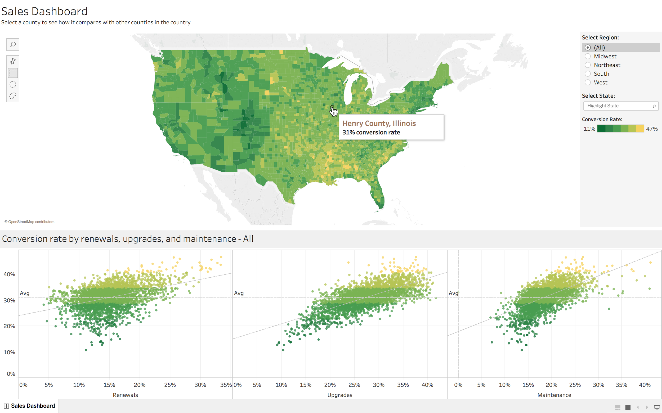
Tableau Dashboard
Tableau will be used to create final Dashboard
Use Visualization from worksheets to visualize credit card fraud
Be able to locate trends using visualization

Slide 8
